Slide 1
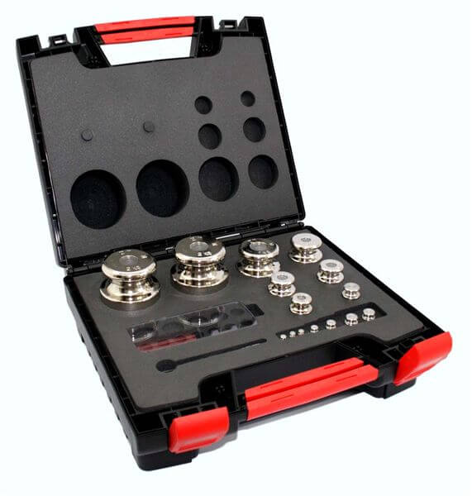
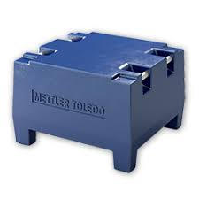
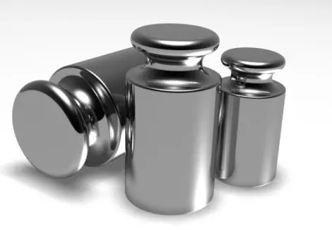
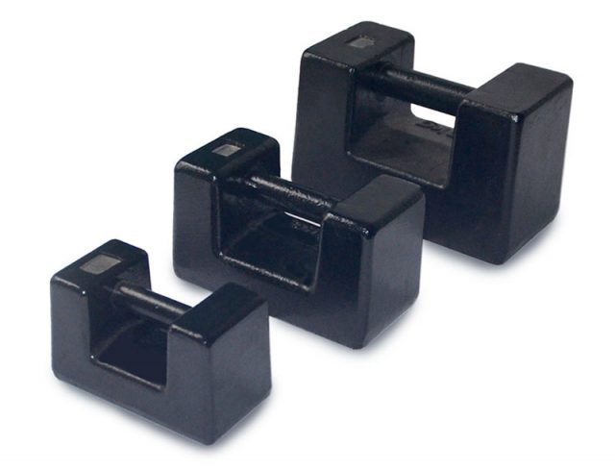
Test weights

Slide 2

Cast Iron Weights
Rectangular / block type
cast iron weights
Features
Constructed from grey cast iron with epoxy finish
Available in the following sizes 5kg, 10kg, 20kg and 1000kg
Rounded corners to prevent chipping
No blind cavities that can hold and accumulate dirt
Adjusting cavity for regular adjustments and verification
Available in Class M1 only
Large clearly visible embossed markings

Slide 3
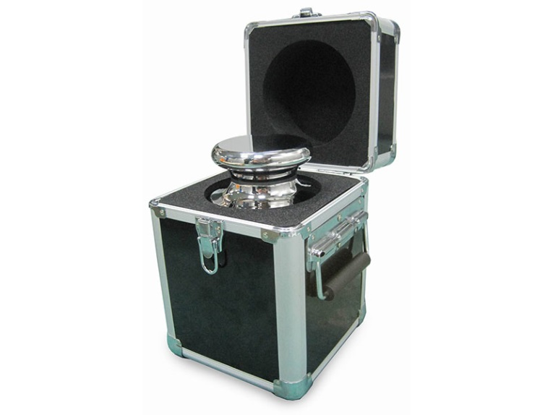

Brass Weights
Cylindrical (nickel plated) Brass
weights
Features
Constructed from brass with nickel plating or polished to a gloss finish
Available in different sizes from 1g to 20kg
Rounded corners to prevent chipping
No blind cavities that can hold and accumulate dirt
Adjusting cavity for regular adjustments and verification
Available in Class M1 only
Large clearly visible embossed markings

Slide 4
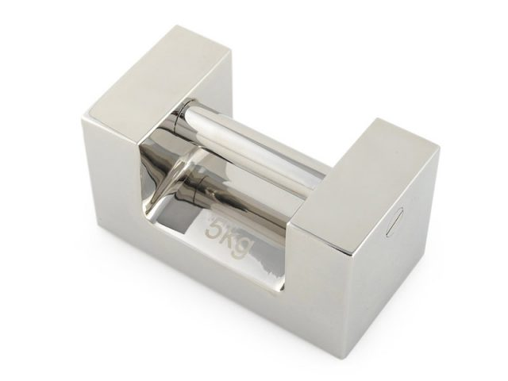
Stainless Steel Weights
Rectangular / block type Stainless
weights
Features
Constructed from stainless steel polished to a high gloss finish
Available in various selected classes from E₁ to M₁ (call office for more information on availability)
Available in various sizes from 5g to 20kg with optional aluminium box for storage
Embossed markings
Rounded corners and edges to avoid chipping
Sealable adjustment cavity to preserve verification
Sets supplied with box as standard

Slide 5
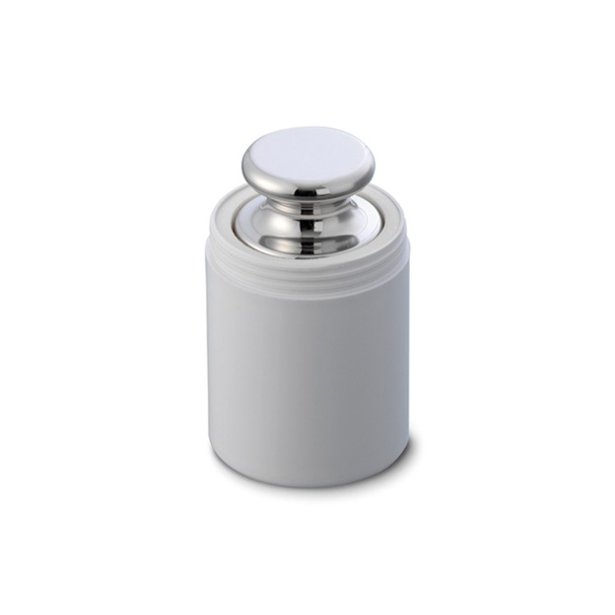
Stainless Steel Weights
Cylindrical Stainless
weights
Features
Constructed from stainless steel polished to a high gloss finish
Available in various selected classes from E₁ to M₁ (call office for more information on availability)
Available in various sizes as individuals from 1g to 20kg with optional of aluminium box for storage
Also available in sets of different configurations with storage box as standard
Embossed markings
Rounded corners and edges to avoid chipping
Sealable adjustment cavity to preserve verification

