Slide 1
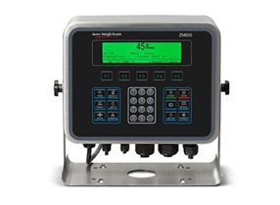
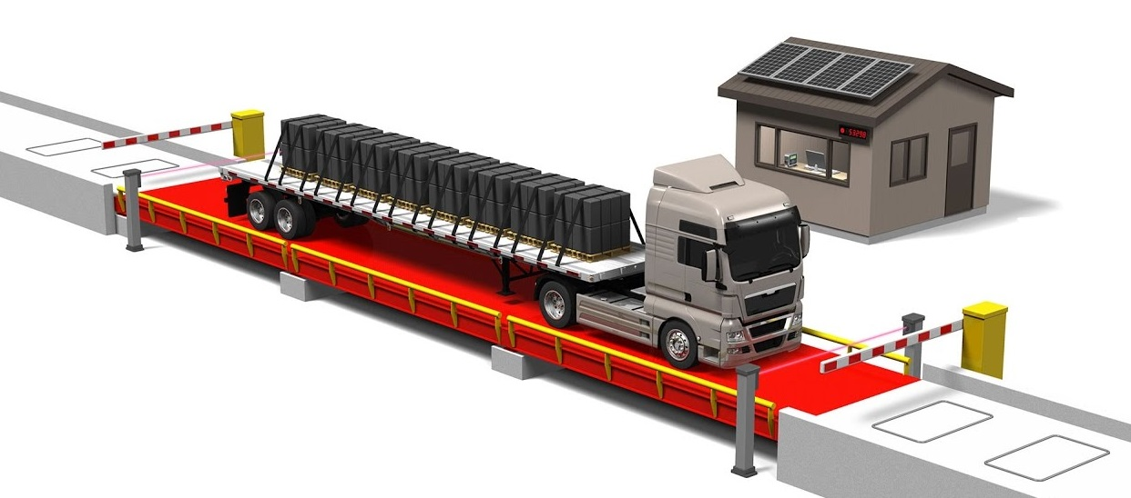
Weighbridges

Slide 2
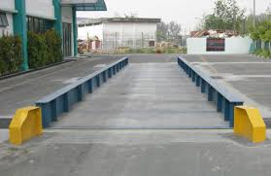
Road Weighbridges
Single Deck Truck scales
Features
Modular construction makes different lengths easy to achieve
Available in different lengths from 6m x 3m to 24m x 3m
Option of above or blow ground mounting
Can be fitted with weight controllers for automatic bull filling of vehicles
Weighbridge management software supplied as standard to improve data integrity and provide audit trails

Slide 3
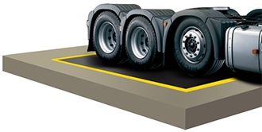
Road Weighbridges
Single Deck Axle weighers
Features
Available in small portable sizes for single axles and large fixed decks for group axles
Ease to install and use
Software available to enable detection of perennially overloading axles
Option of above ground or pit mounting

Slide 4
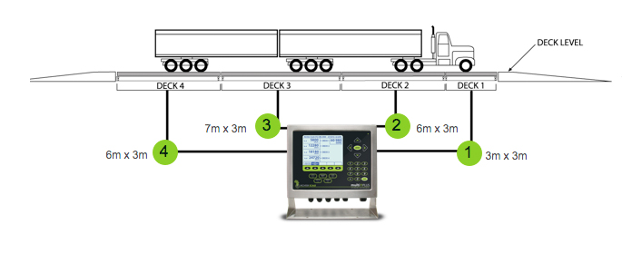
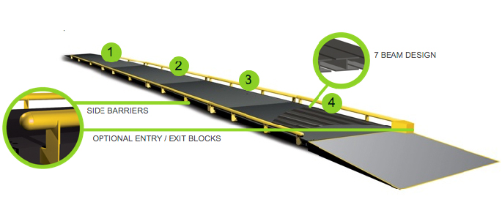
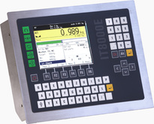
Road Weighbridges
Multiple Deck Axle weighers
Features
Available in 24m x 3m length in a 3,7,7,7 configuration or 22m x 3m in a 3,6,7,6 configuration
Supplied with the Systec IT8000E Truck terminal or the Multi-Plus system
Can weigh all the axils of a super-link truck at one go.
Special software that allows the capturing of individual axil weights and totalize the weights if necessary.
Suitable for vehicle weights monitoring by road authorities or transport operators who need to avoid unnecessary tyre wear and axil damage due to overloading.

Slide 5
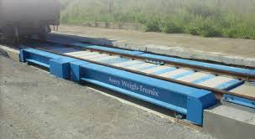
Rail Weighbridges
Static Rail weighbridges
Features
Can be available as single or dual decks
Dual decks allow weighing of different size wagons on the same weighbridge
Pit or surface mounting
Management software
Highly accurate weights legal for trade use

Slide 6
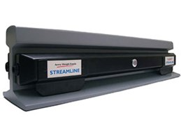

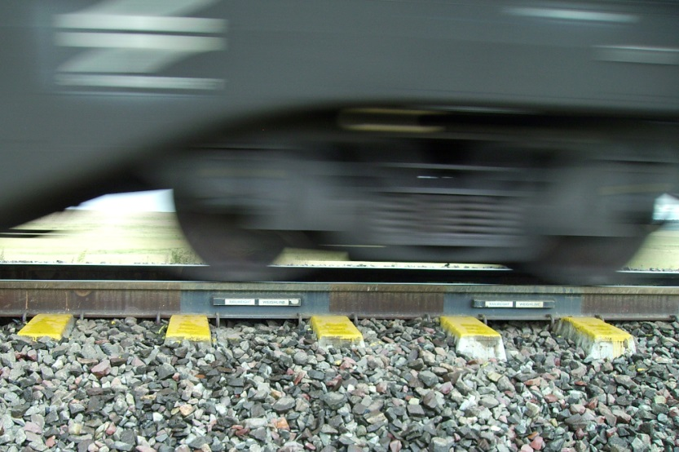
Rail Weighbridges
Dynamic / In-motion Rail weighbridges
Features
Fast accurate weighing of rail wagons in motion
Fast and relatively cheaper installation and maintenance
No cost of building foundations
Management software supplied as standard makes it easier to track wagon weights
Available in different configurations and lengths determined by the number of sensors (more sensors means higher accuracy)
Supplied with Avery Weigh-tronix ZM605 indicator
Illustration of sensor mounting

